Slide 1
Revised diffusion manuscript
In this study, the uncertainties of diffusion-based temperature proxies are estimated.

Slide 2
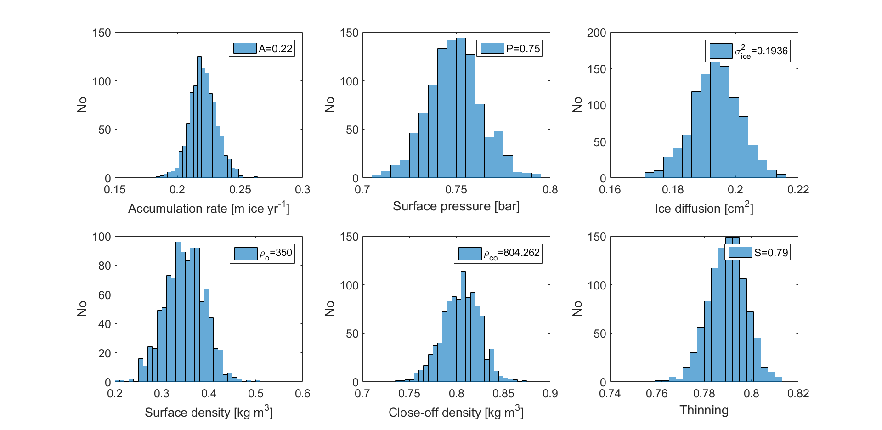

Slide 3
Some parameters are more well-defined than others
Parameter | Uncertainty
Accumulation rate | A = A_mean + A_mean*0.05*rand(1)
Surface pressure | P = P_mean + P_mean*0.02*randn(1)
Ice diffusion | Sigma_ice = sigma_ice_mean + sigma_ice_mean *0.02 *randn(1)
Surface density (like Gkinis et al (2014)) | rho_o = rho_o_mean + 0.040*randn(1)
Close-off density | rho_co = 0.804262 + 0.020*randn(1)
Thinning (pretty well-defined) | S = S_mean + S_mean*0.01*randn(1)

Slide 4
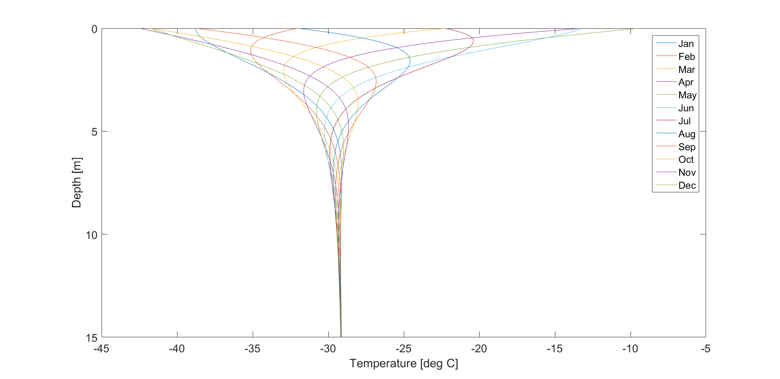
Seasonal-dependent temperature profile

Slide 5
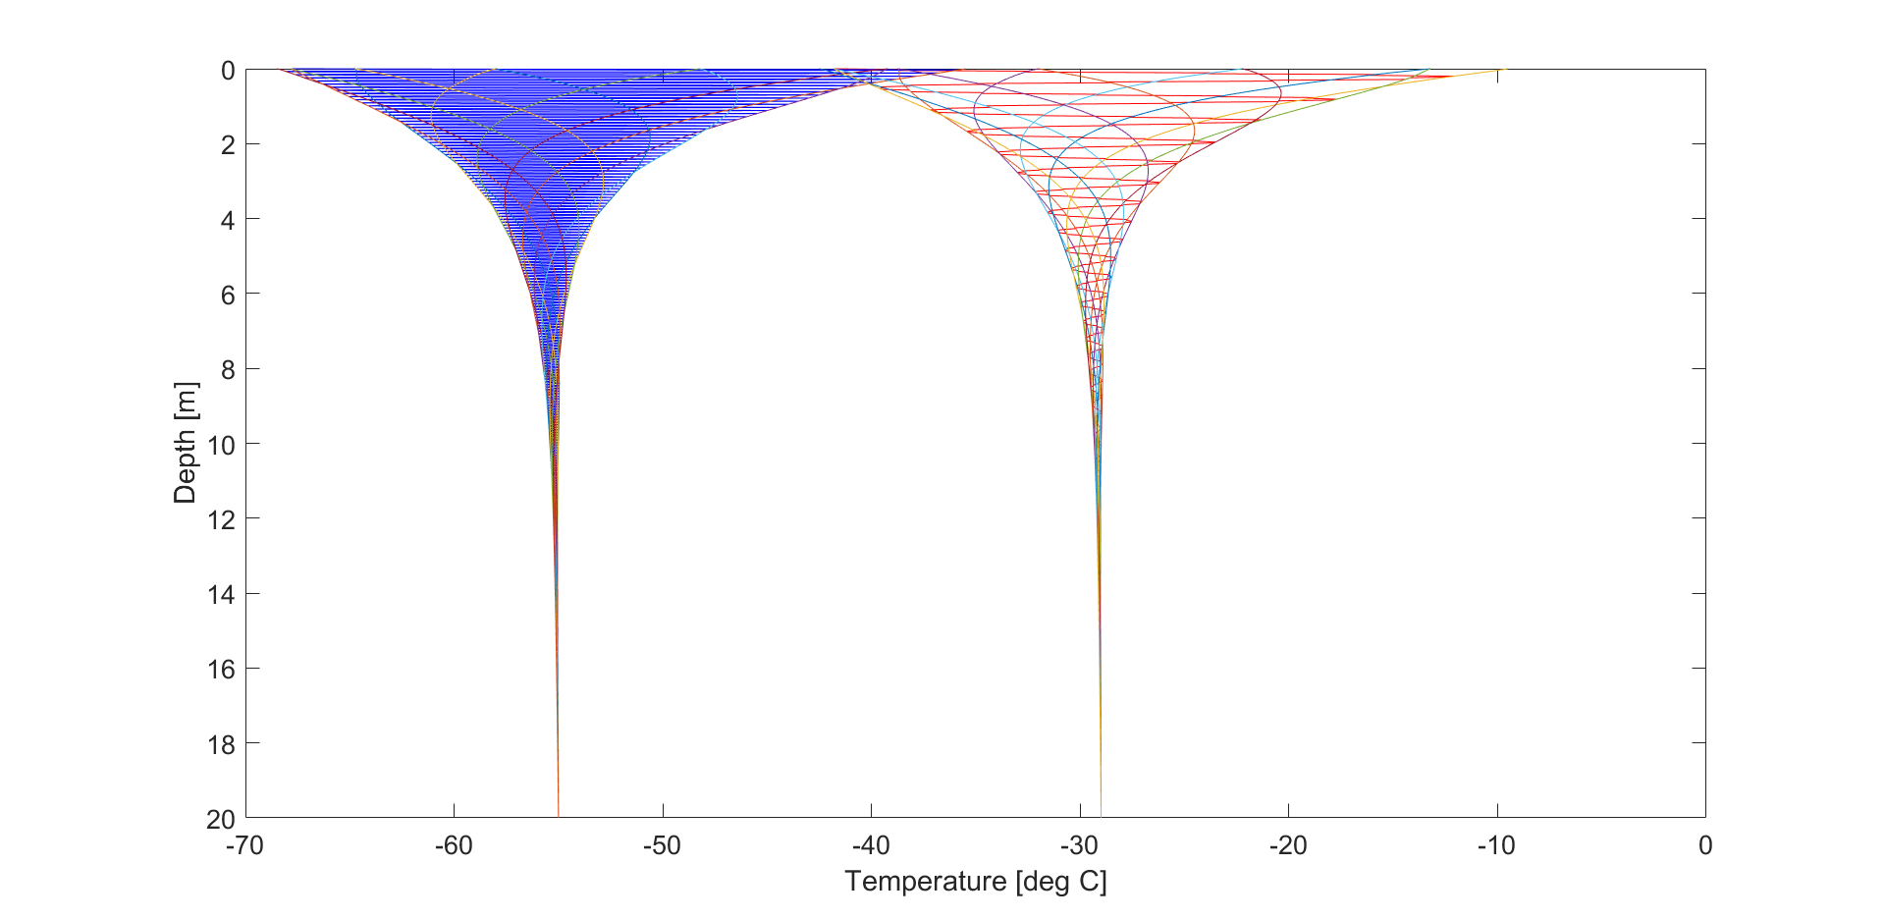
Seasonal-dependent temperature profile

Slide 6
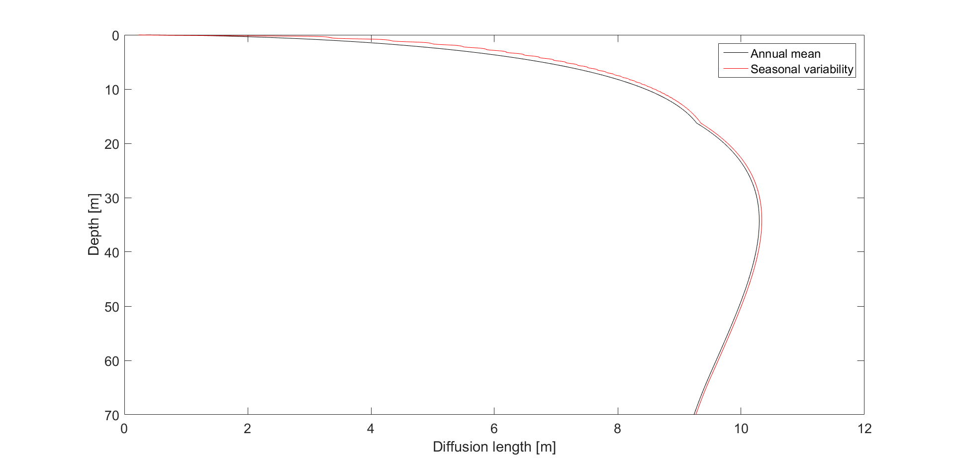
Firn diffusion model 0.1 cm in difference in ice-equivalent

